Slide 1
Boston Rental Price Prediction
Dan Wang
University of Massachusetts Amherst
04/23/2018

Slide 2
Motivation:
Very difficult to estimate the “fair” rent for a property, for both tenants and landlords
Many features can affect the rent: square footage, location, No. of bedrooms/bathrooms, even recent rents of nearby properties
Machine learning is the idea approach to estimation rental price because it helps to find the optimal parameters should be applied to each feature

Slide 3
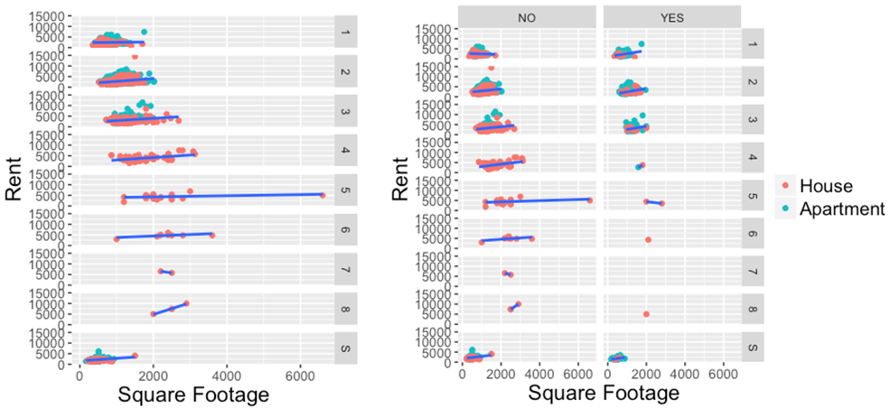
Rent vs. square footage:

Slide 4
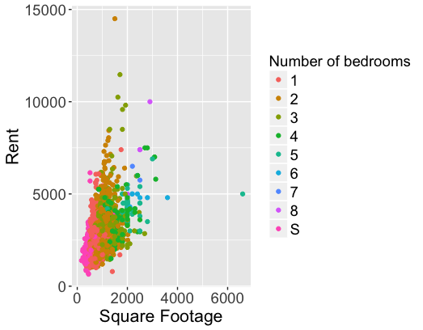
Rent vs. square footage:

Slide 5
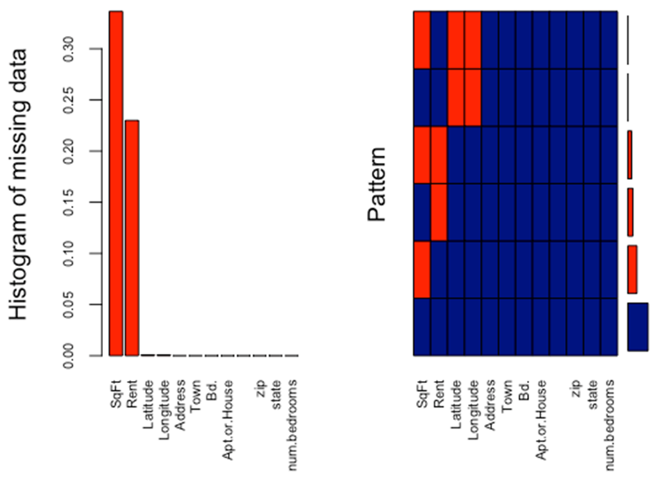
Data imputation:

Slide 6
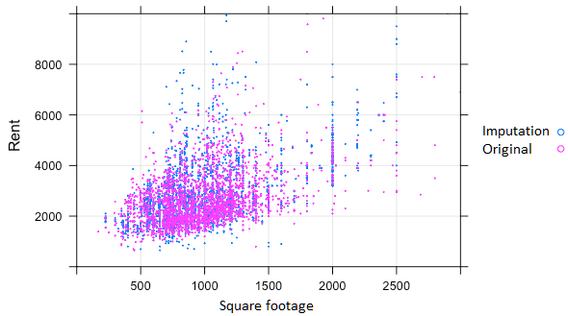
Data imputation:

Slide 7
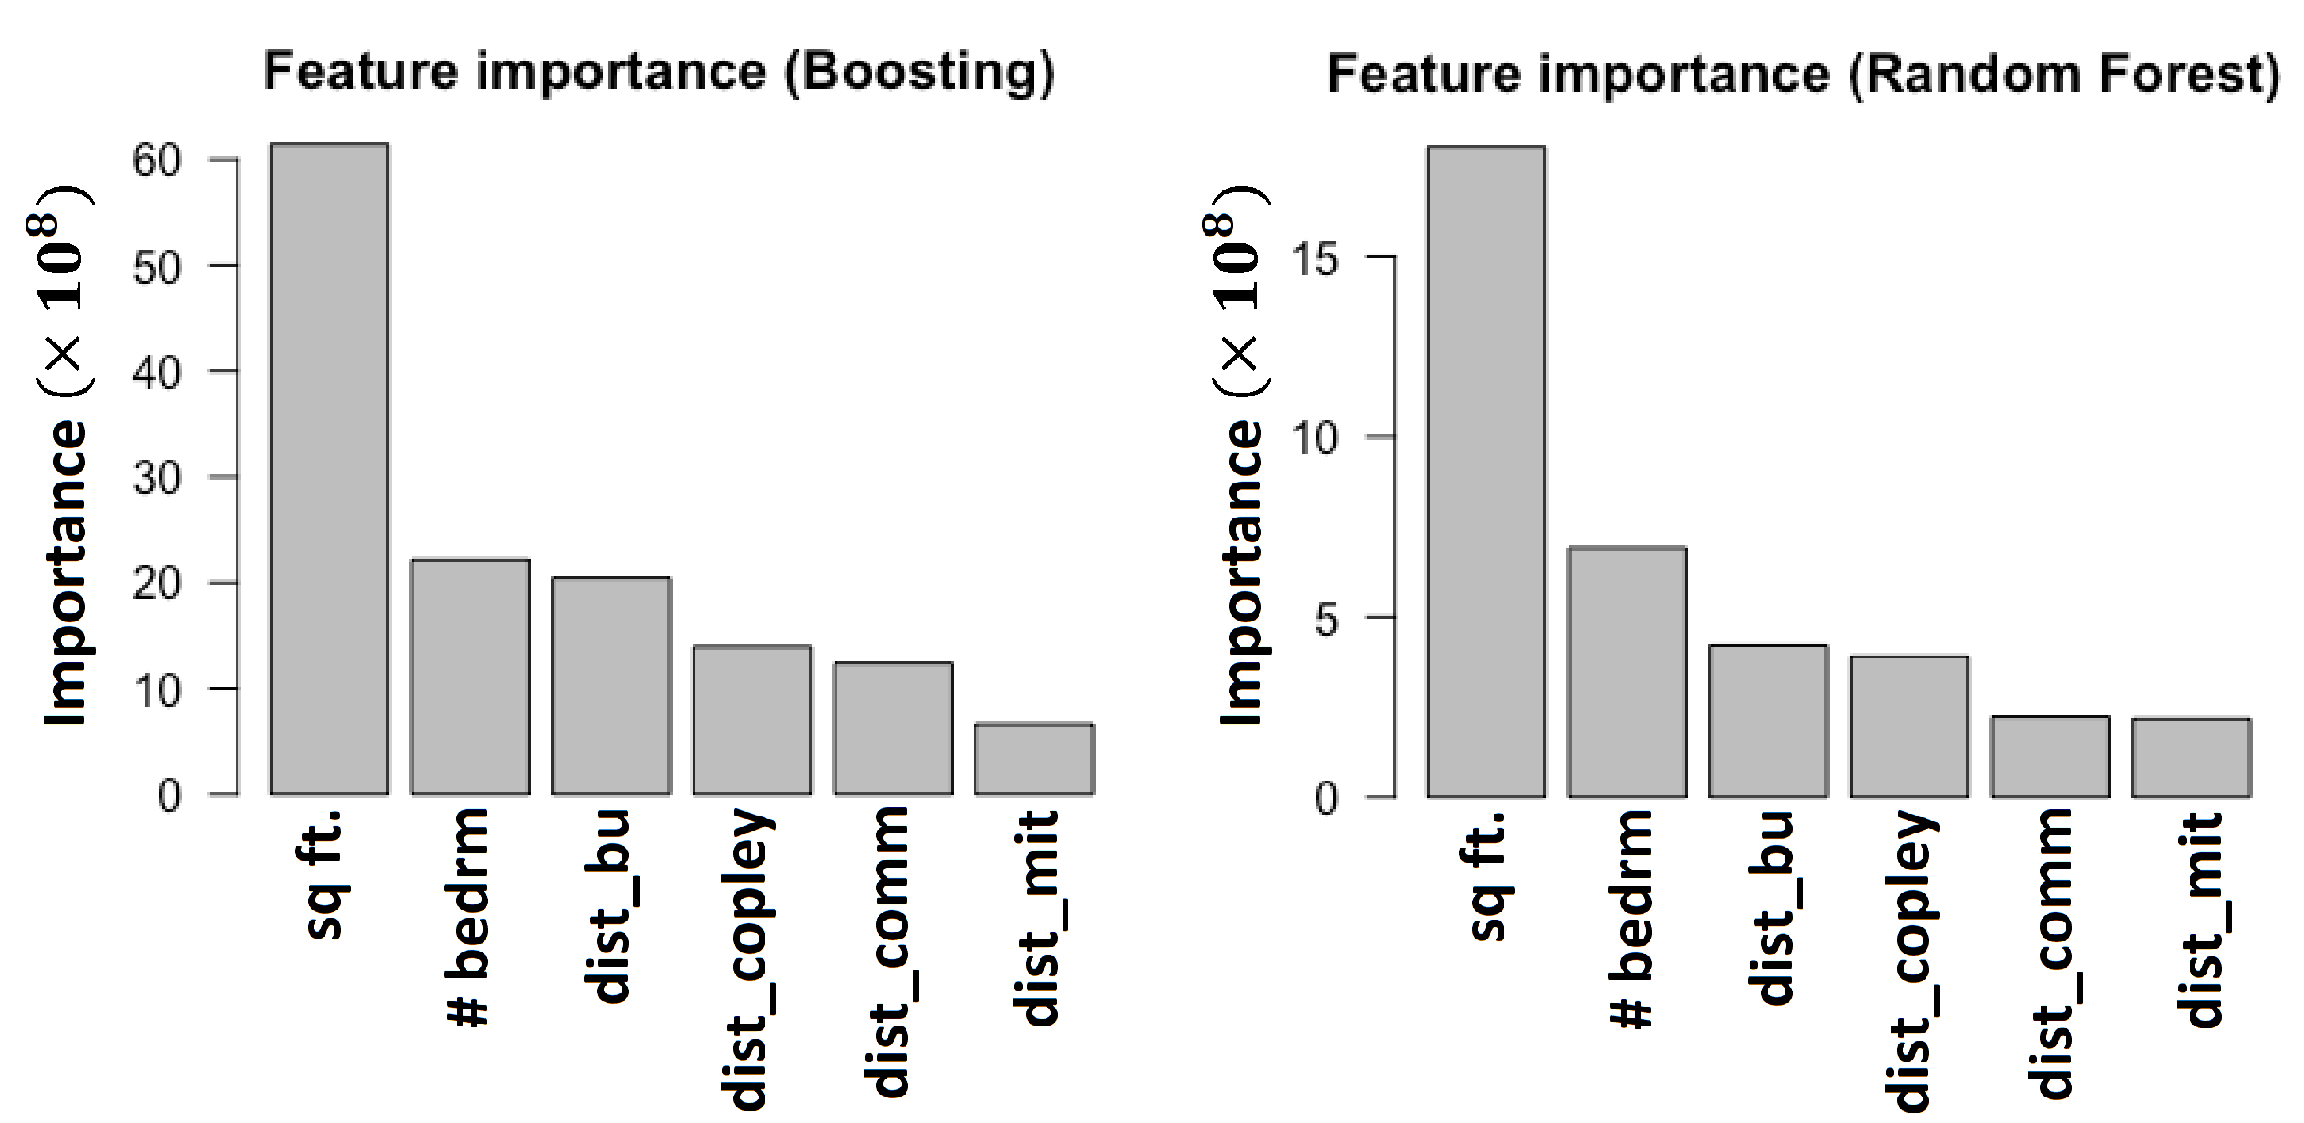
Feature importance:

Slide 8
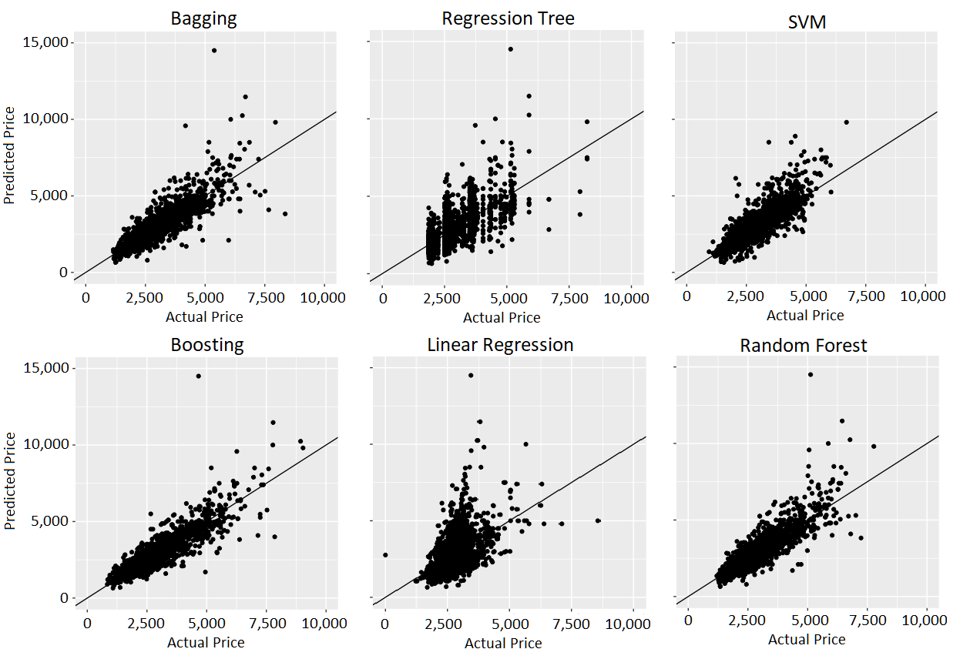
Model comparison(regression):

Slide 9
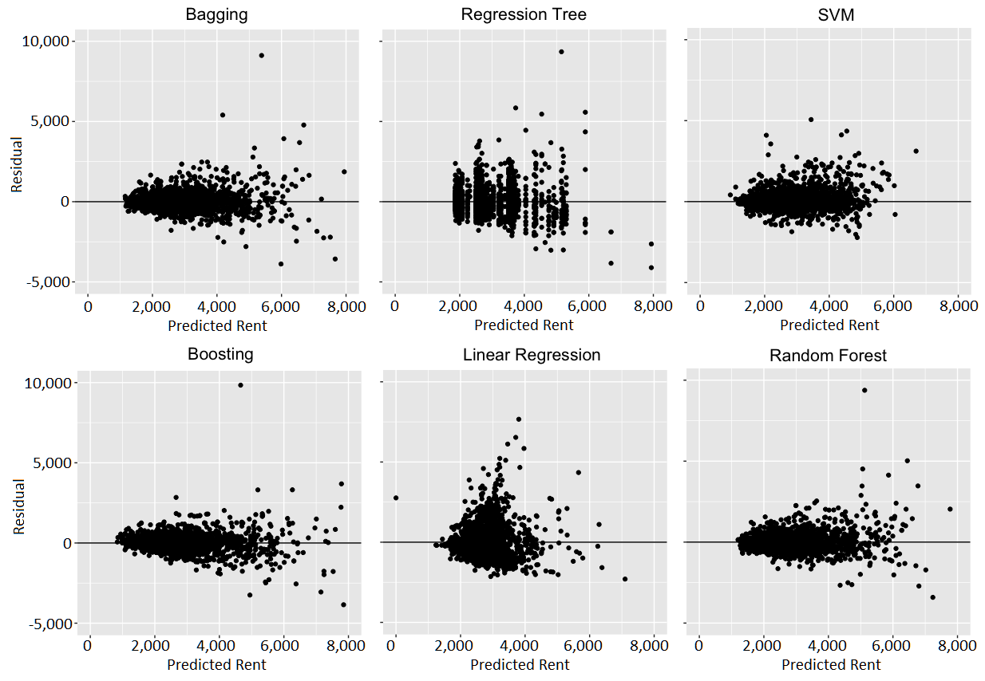
Model comparison (residual):

Slide 10
Model comparison (residual):
Model | RMSE
Bagging | 527
Reg. Tree | 767
SVM | 561
Boosting | 481
Linear Regression | 812
Random Forest | 507

